Slide 1


Capstone Project - 1
Airbnb Booking Analysis
Sujit Musale
(Self Project)

Slide 2
About Airbnb…….
Airbnb, Inc. is based in San Francisco, California.
operates an online marketplace
Basically focused on short-term homestays and experiences.
The company acts as a broker and charges a commission from each booking.
The company was founded in 2008 by Brian Chesky, Nathan Blecharczyk, and Joe Gebbia.
Airbnb is a shortened version of its original name, AirBedandBreakfast.com.
Airbnb provide services in Europe, United States,canada and asia.

Slide 3
Problem statement…..
We have given with the data of 49000 rows and 16 columns and it’s having categorical and numerical values.
We are trying to find out solution of below listed question's
And more than that.
What can we learn about different hosts and areas?
What can we learn from predictions? (ex: locations, prices, reviews, etc)
Which hosts are the busiest and why?
Is there any noticeable difference of traffic among different areas and what could be the reason for it?

Slide 4
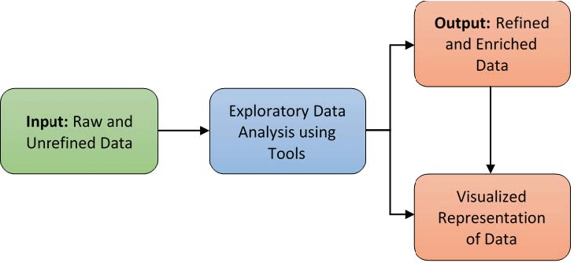
EDA process flow …..
3
1
2
4

Slide 5
Dependent variable’s Details …..
Id – unique id of each customer
Name – apartment, room or home name.
Host_id – owner or host unique id
Host_name - name of owner or host.
Neighbourhood_group – especially the name of zone like manhantum, brooklyn etc.
Neighbourhood – are near from booking location.
Latitude and longitude – geographical coordinates of booking location.
Room type – specify the type of room.
Price – room booking price.
Minimum_neights – customer stay count in terms of nights.
Number_of_reviews – total number of reviews given by the customer for particular property.
Last_revies – date of last review.
Review_per_month – average review per month.
Availability_365 – property available (days) in the year for customers.

Slide 6
Loading Data & Null values treatment …..
We got some of the dependent variables are having null values are as follows.
From above chart we can see that “ last review” and “ review_per_month” are having large number of missing value. We fill this with “zero”.
Name and host name are less In count so will drop that rows.
Sr no. | Dependent variable’s | Number of null values
1. | Name | 16
2. | Host_name | 21
3. | Last_review | 10,052
4. | Reviews_per_month | 10,052

Slide 7
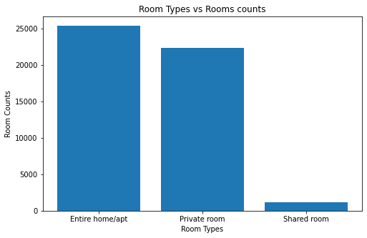
EDA …..
Here are “three” type of rooms Available as per room Type:
Entire home/apt - 25409
Private room - 22326
Shared room – 1160
“Shared rooms are very less
As compared to other room’s.”

Slide 8
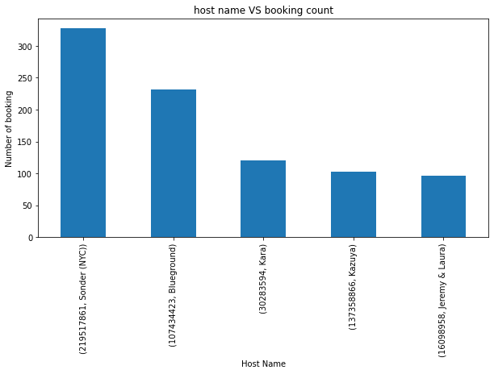
EDA (continued…..)
Here are top 5 host from the list with host ID:
Host_id Host_name Counts
219517861 Sonder (NYC) 327
107434423 Blueground 232
30283594 Kara 121
137358866 Kazuya 103
16098958 Jeremy & Laura 96
. “approx 1% of the total host are
top fiver host.”

Slide 9
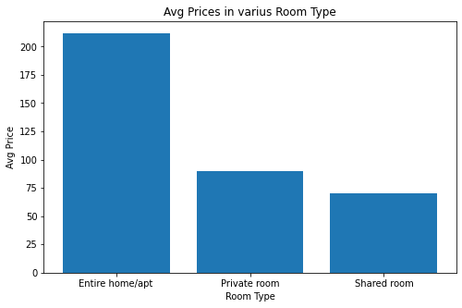
EDA (continued…..)
Here are Average or mean room price w.r.t Room type:
Room type avg. price($)
Entire home/apt 211
Private room 89
Shared room 70 .
“entire home/apt are having more
Than doubled mean price of other
Room types.”

Slide 10
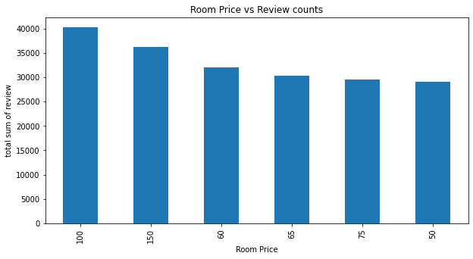
EDA (continued…..)
Here are Number of review vs Room Price:
price($) Review Count’s
100 40293
150 36196
60 32096
65 30292
75 29590
50 29069
“ we can say that rooms with large
Number of review counts are having
Some issue”

Slide 11
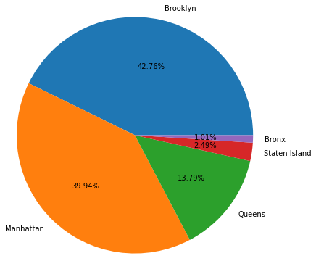
EDA (continued…..)
Reviews distribution along vs
neighbourhood group:
Neighbourhood group Review count’s
Brooklyn 486574
Manhattan 454569
Queens 156950
Bronx 28371
Staten Island 11541
“So here also no any noticeable variation in total review by location point of view.
as Manhattan & Brooklyn having high number of service or booking there respective review are also high”.

Slide 12
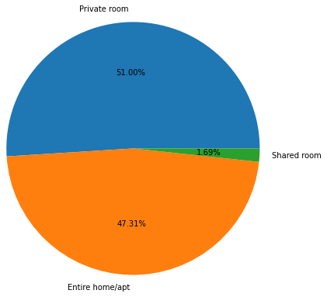
EDA (continued…..)
Reviews distribution along various Room Type:
Room Type Review count’s
Entire home/apt 580403
Private room 538346
Shared room 19256
“We can observe from above pie chart there is no any issue with room type though shared room type is having less value we all know that the count of this room type is very low as compared to Entire home/app and privet room”.

Slide 13
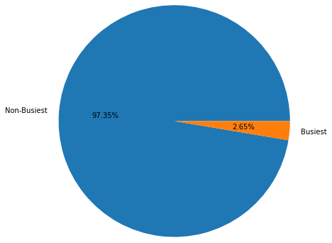
EDA (continued…..)
Busiest and Non- Busiest host distribution on pie chart:
Busiest host – 1295
Non Busiest Host - 47600
“Only 2.65% of host are Busiest Host”.

Slide 14
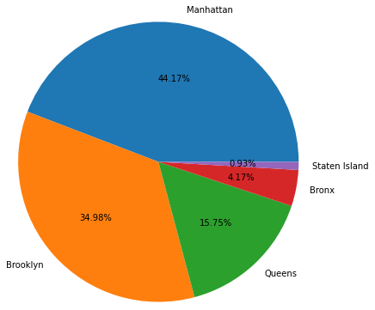
EDA (continued…..)
Busiest host distribution
according to area on pie chart:
Location No of Busiest host
Manhattan 572
Brooklyn 453
Queens 204
Bronx 54
Staten Island 12
“so its very clear that the location
where most number of booking are present at that location host are busy”.

Slide 15
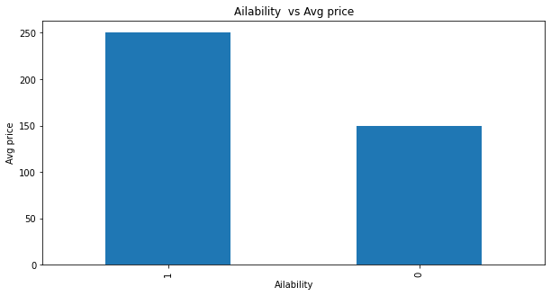
EDA (continued…..)
Busiest and Non Busiest host avg. price comparison:
Host type Avg. Price($)
Busiest Host 250
Non Busiest Host 150
“it is clear that the busiest rooms are having avg. price around 250 pounds and other rooms are having less average price around 150 pound.”.

Slide 16
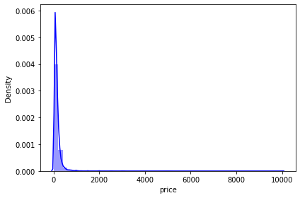
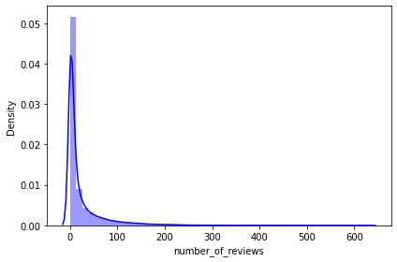
EDA (continued…..)
Distribution plot: Price and number of review
“ Both are positively skewed”
Price vs Density number_of_reviews vs Density

Slide 17
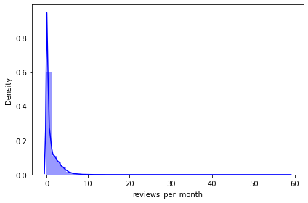
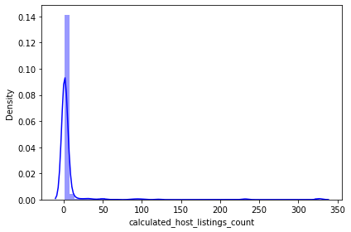
EDA (continued…..)
Distribution plot: review per month and calculated host listing count
“ Both are positively skewed”
review per month vs Density Calculated host listing count vs Density

Slide 18
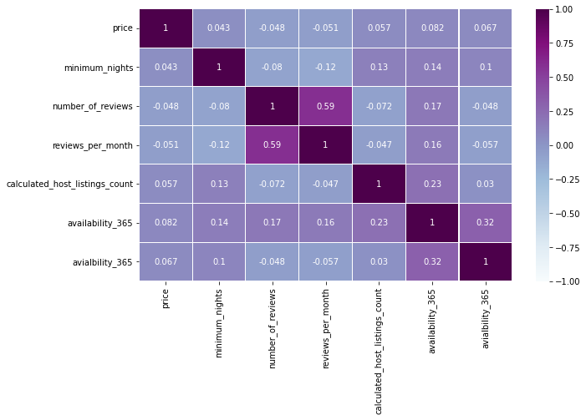
EDA (continued…..)
Correlation chart:
Here
‘review_per_month’ and
‘number_of_review’
are having some
Correlation of 0.59
but all other variable are
Having less correlation
than that of this.

Slide 19
EDA (continued…..)
Conclusion:
Most visitors don't prefer shared rooms, they tend to visit private room or entire home.
Manhattan and Brooklyn are the two distinguished, expensive & posh areas of NYC.
Though location of property has high relation on deciding its price, but a property in popular location doesn't mean it will stay occupied in most of the time.

Slide 20
Thanks

